Slide 1


A Multimodal Chinese NER Dataset with Speech Clues
Speaker: Dianbo Sui
National Laboratory of Pattern Recognition, Institute of Automation, Chinese Academy of Sciences dianbo.sui@nlpr.ia.ac.cn

Slide 2


Motivation
Some interesting cases：
新能源汽车人才有机会落户上海
无线电法国别研究
南京市长江大桥
Notes:
现在汽车人之前内卷也这么严重吗？卡车人，和油车人都不行？

Slide 3
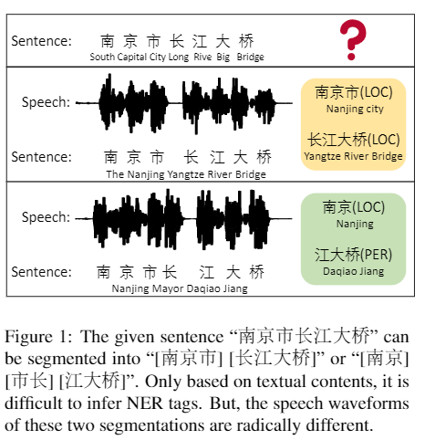
Motivation
In this work, we pay special attention to Chinese multimodal NER with both textual and acoustic contents.
Current studies on multimodal NER are limited in English, and totally skirt other languages.
The acoustic modality can play a unique role in Chines NER, especially in providing precise word segmentation information
Notes:
Federated Framework

Slide 4
What We Have Done
We construct a large-scale human annotated Chinese NER dataset with Textual and Acoustic contents, named CNERTA.
Based on the dataset, we establish a family of strong and representative baselines.
Upon these strong baselines, we further propose a simple multimodal multi-tasking model.

Slide 5
Dataset Acquisition
There are two possible way to build such a dataset:
Hiring hundreds of people to add the acoustic content to the current existing dataset, such as MSRA
Annotating an exist ASR dataset, such as Aishell-1
Notes:
a large-scale automatic speech recognition dataset for Chinese. In this dataset, text transcriptions are chosen from five domains: “Finance”, “Science and Technology”, “Sport”, “Entertainments” and “News”. There are 400 participants in the recording, and the gender of participants is balanced with 47% male and 53% female. Speech utterances are recorded via three categories of devices in parallel, which are a high fidelity microphone working at 44.1 kHz, 16-bit, Android phones working at 16 kHz, 16-bit, and Apple iPhones working at 16 kHz, 16-bit.

Slide 6
Dataset Acquisition
We choose Aishell-1 as our annotated dataset
A widely-used ASR dataset for Chinese
Text transcriptions are chosen from five domains: “Finance”, “Science and Technology”, “Sport”, “Entertainments” and “News”.
There are 400 participants in the recording, and the gender of participants is balanced with 47% male and 53% female.
Speech utterances are recorded via three categories of high fidelity devices in parallel
Notes:
ASR语音识别数据集
a large-scale automatic speech recognition dataset for Chinese. In this dataset, text transcriptions are chosen from five domains: “Finance”, “Science and Technology”, “Sport”, “Entertainments” and “News”. There are 400 participants in the recording, and the gender of participants is balanced with 47% male and 53% female. Speech utterances are recorded via three categories of devices in parallel, which are a high fidelity microphone working at 44.1 kHz, 16-bit, Android phones working at 16 kHz, 16-bit, and Apple iPhones working at 16 kHz, 16-bit.

Slide 7
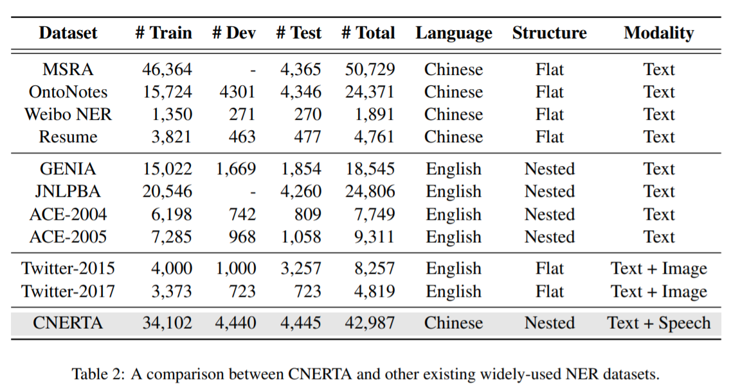
Dataset Statistics

Slide 8
Baselines
Text-only models
Open-Source NLP Toolkit
BiLSTM-CRF
PLM-CRF
Lexicon-Enhanced Model:
Lattice-LSTM
ZEN
Multimodal Model:
Cross-Modal Attention Module and Multimodal Interaction Module

Slide 9
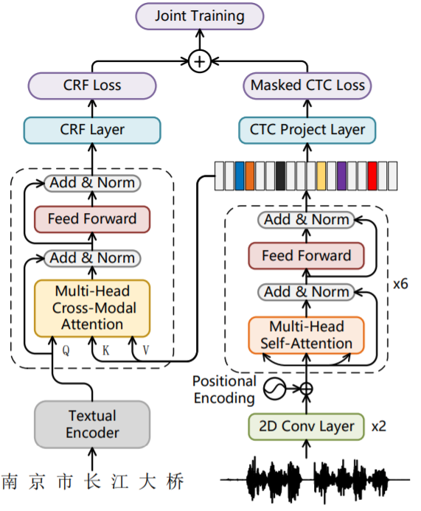
Proposed Method
Previous multimodal methods ignore a natural monotonic alignment between the acoustic modality and the textual modality.
We propose a multimodal multi-tasking model, called M3T.
Notes:
ASR语音识别数据集
a large-scale automatic speech recognition dataset for Chinese. In this dataset, text transcriptions are chosen from five domains: “Finance”, “Science and Technology”, “Sport”, “Entertainments” and “News”. There are 400 participants in the recording, and the gender of participants is balanced with 47% male and 53% female. Speech utterances are recorded via three categories of devices in parallel, which are a high fidelity microphone working at 44.1 kHz, 16-bit, Android phones working at 16 kHz, 16-bit, and Apple iPhones working at 16 kHz, 16-bit.

Slide 10
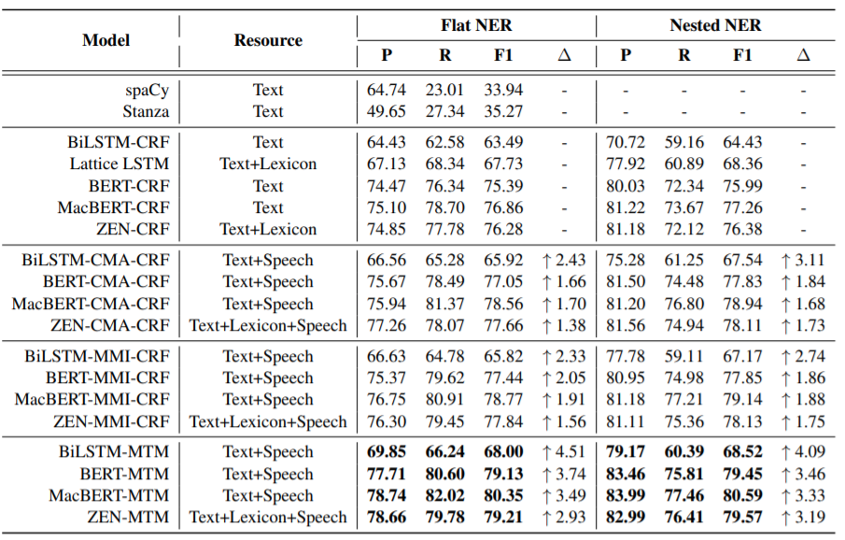
Experiments

Slide 11
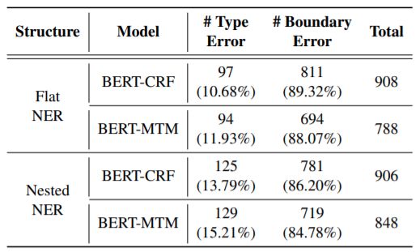
Error Analysis

Slide 12
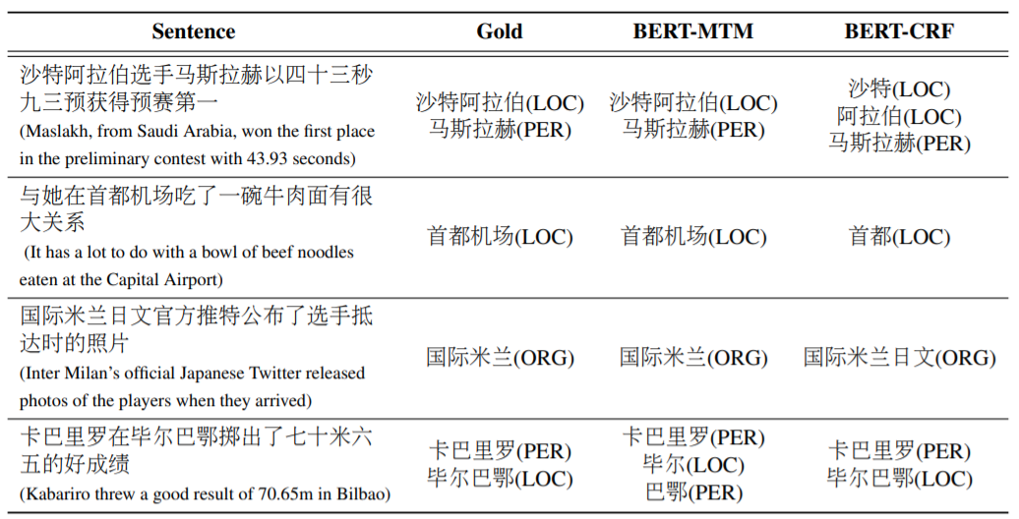

Case Studies

Slide 13
Thanks for Your Time！

